Slide 1


ToDP Rotation: Urgency vs. New
& Reactions to Current ToDP Experiment
Kelly Peterson
Date: Aug 18 2023

Slide 2

Research Objectives & Approach
RESEARCH PARTICIPANTS
Occasional Cx (once a month or less often)
Do not have a current DashPass subscription
Are not located in ToDP test markets
ROTATION
For the ToDP offer to reach its full potential, Cx need to understand the concept of rotation.
This research aims to understand which approach will be the most clear for Cx while also exciting Cx and motivating them to place an order.
6, 20 min 1:1 Interviews
Cx were exposed to two different ToDP approaches on the homepage as well as the ordering flow.
The full research brief can be found here.
Notes:
James to link to failed session

Slide 3
Rotation Reactions

Slide 4
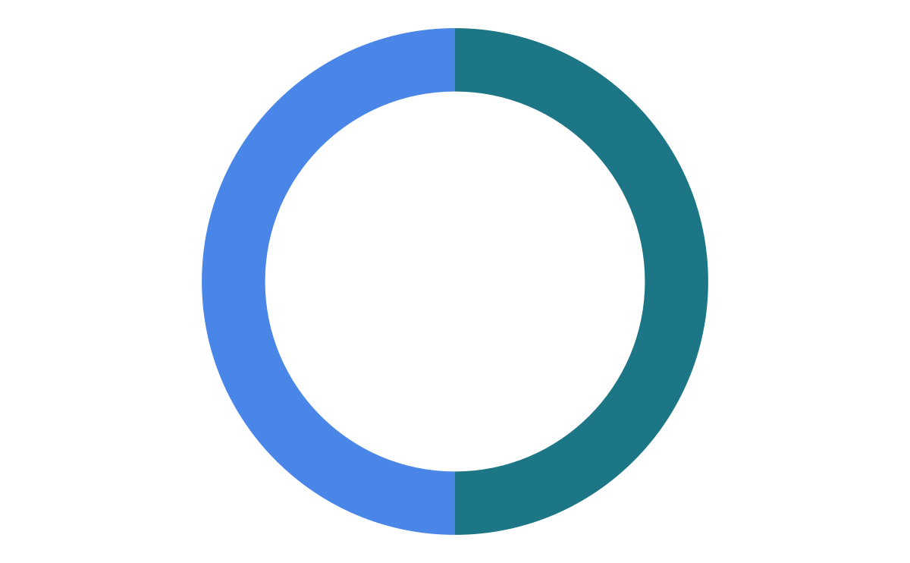


50/50 split on timer vs. new
Timer
New
Time catches their eye first
Cx want to make sure they recognize savings in the time before it goes away
Feel motivated to look into the Rx available for that offer
Interpreted as “new way to save”
The new was clear, but not necessarily exciting
Preferred among Cx who felt the timer had too much time/was not going to impact them
Notes:
James to link to failed session

Slide 5
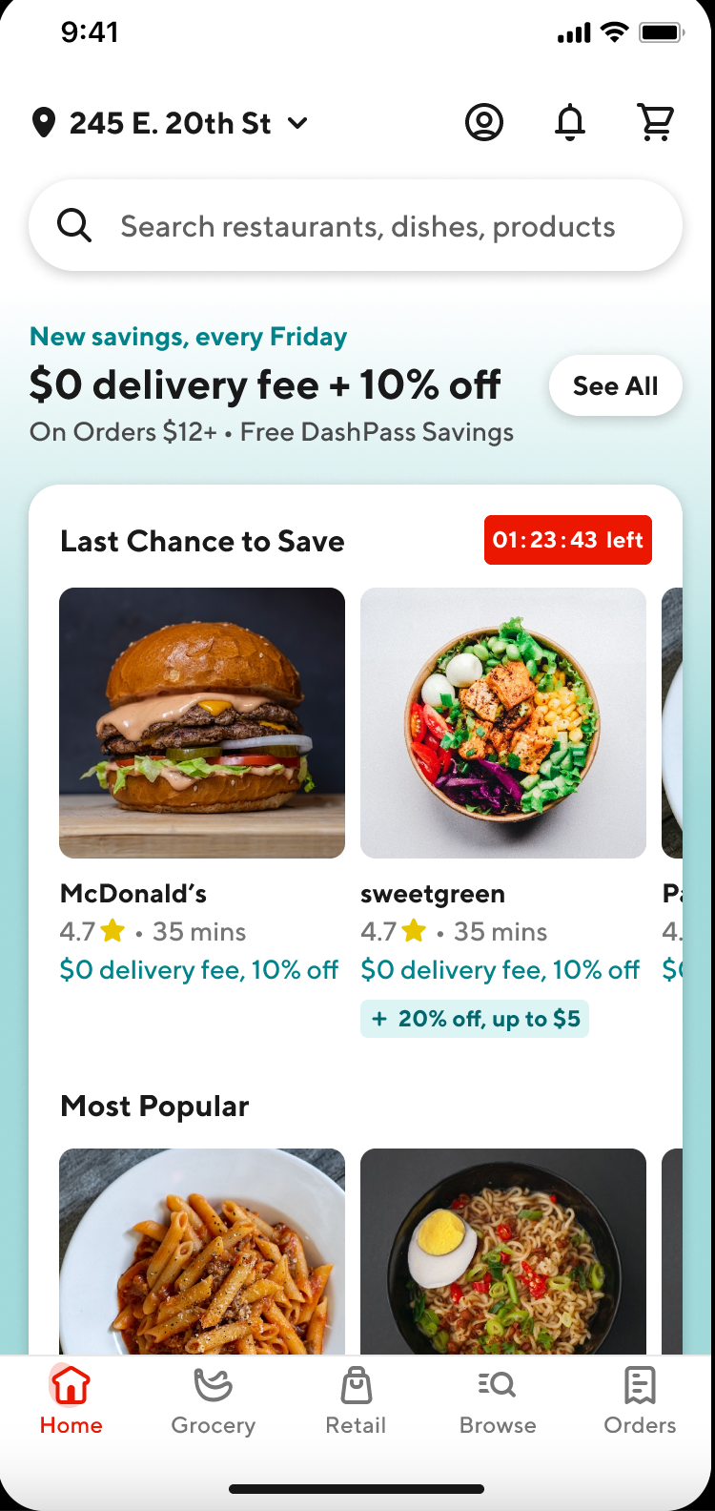
Opportunity to provide more clarity on the home page
Cx though the savings were only available on Fridays (especially in timer version)
Cx wanted to click “see all” to see Rx and know how it all works
Cx did not know that Last Change to Save was connected to $0 delivery fee and 10% off
Some Cx thought you had to have DashPass or that it was a trial
Cx thought the coupon was going away
Notes:
James to link to failed session

Slide 6

Last Chance to Save Confusion

Slide 7

DashPass Confusion
Cx who thought it was a DashPass promotion were also more likely to think it was a one-time offer

Slide 8
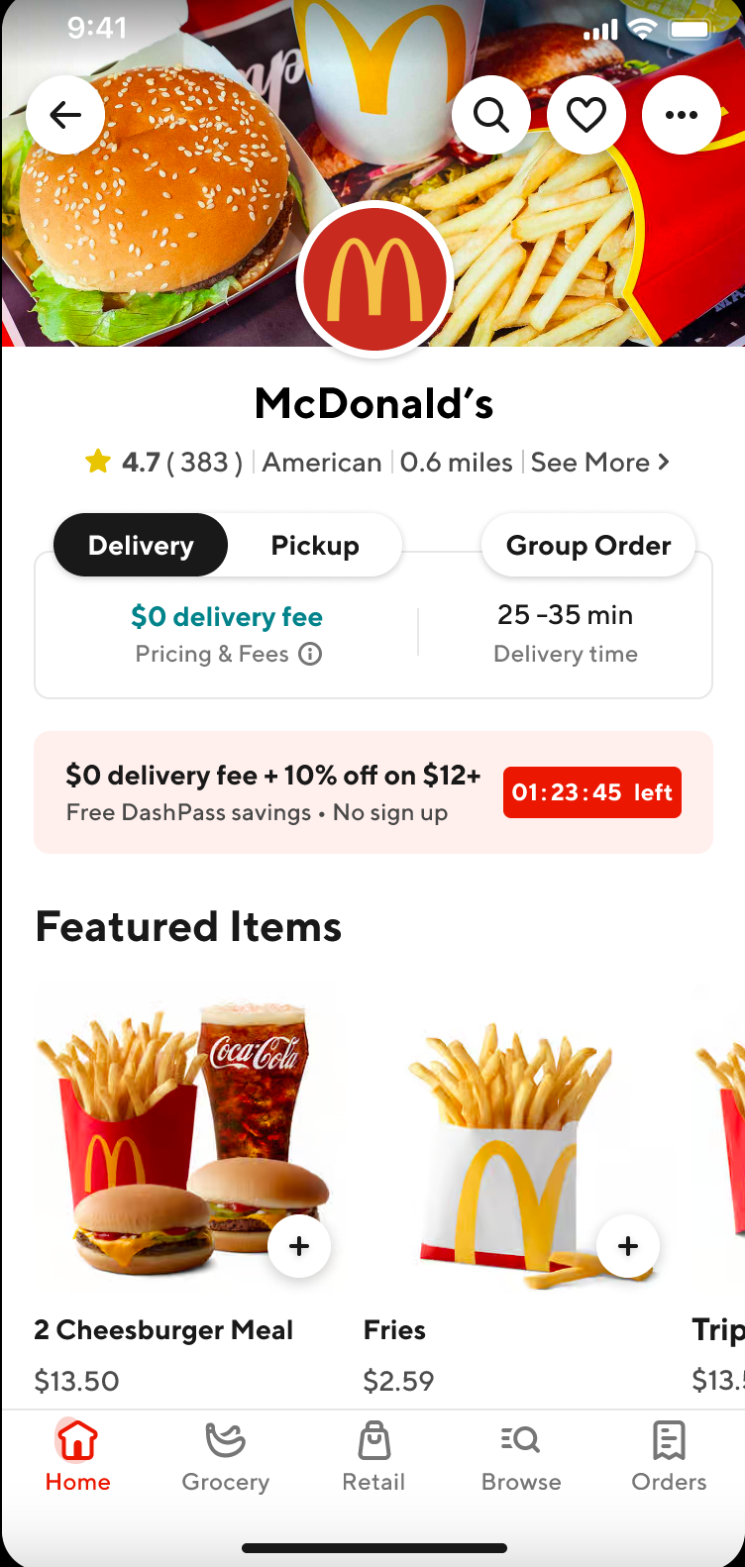
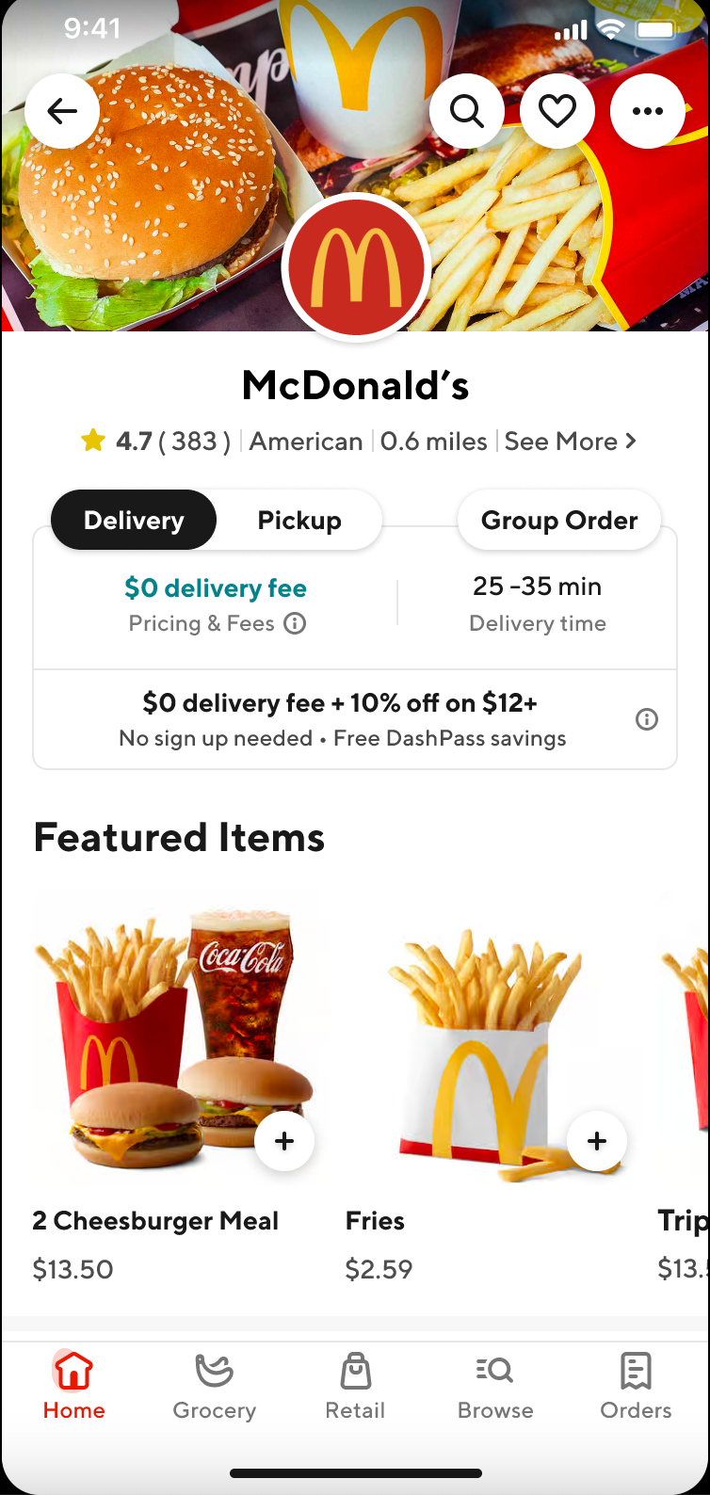
Timer store page provides more clarity than new
Overall the words “no sign up” have the greatest impact
Connection to timer clarifies savings
Lack of visual differentiation get’s lost & continues DP confusion until “no sign up” is viewed
Notes:
James to link to failed session

Slide 9
Store Page Timer

Slide 10
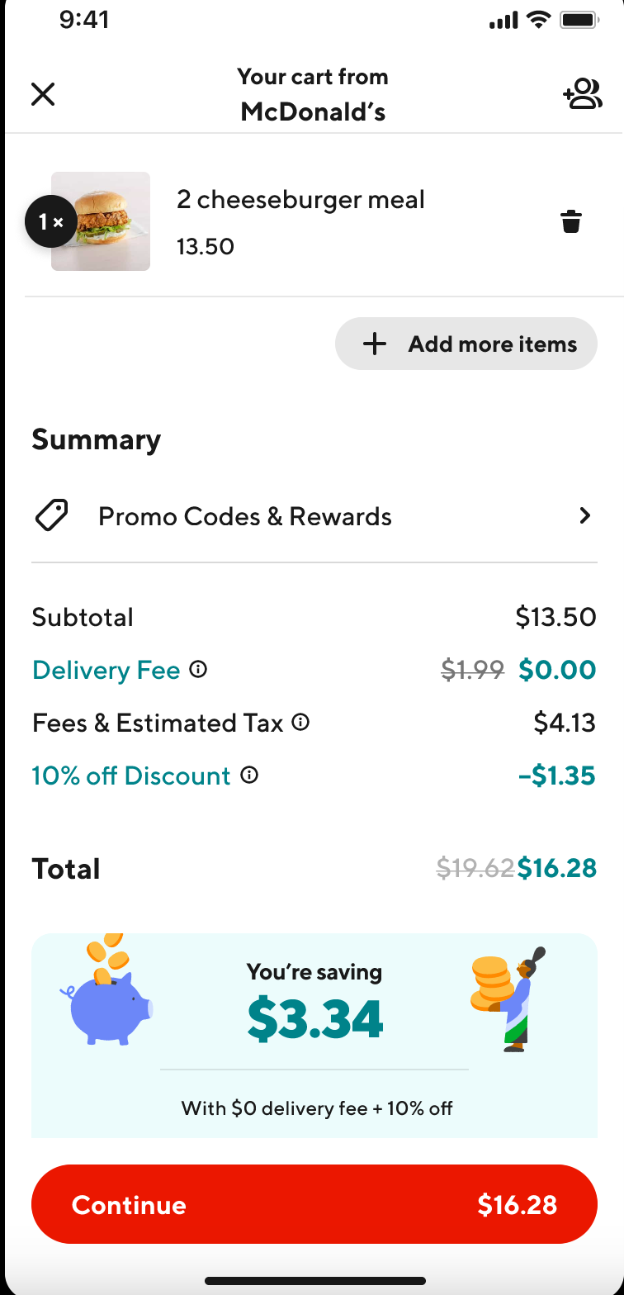
Cx are happy with summary at checkout
Cx love seeing the strikethrough of the overall title coupled with the savings below
Most Cx felt it was really clear to see where the savings are
One price sensitive Cx mentioned that the fees/taxes number seems high and that would dissuade them from placing an order if the 10% discount wasn’t there
Notes:
James to link to failed session

Slide 11
Cx are not sure if they will order more, but think they may visit the app more frequently
In theory: With a 1/3rd conversion rate; Increased visitation= increased OR.
How can we ensure that DoorDash, and Taste of DashPass, remain top of mind for occasional Cx?
What is the right hook, to make OCCx think about DoorDash more frequently?
Notes:
James to link to failed session

Slide 12
ToDP Pulse (non-converts)

Slide 13



Cx input aligns with team concerns for not converting
Lack of Awareness
DashPass Confusion
Selection
1 Cx just did not see the savings offer, they went directly to their Rx of interest when visiting the app
1 Cx opened their phone to look for it and missed it because they were on their boyfriends address which was outside of market
2 Cx mentioned some sort of “savings only for DashPass” experience
One Cx though she does not get offers because she canceled DashPass
One Cx actually placed a ToDP order but didn’t see the 10% savings and thought that she didn't get it because she didn’t have DashPass
Two Cx mentioned that they wanted to order from Wingstop but they did not currently have drivers on Dashpass
One of these Cx did notice the ToDP offer but did not place an order because they wanted Wingstop

Slide 14
Recommendations

Slide 15

V2 and beyond
DashPass brand connections should be gentler and later in the flow
Prioritize timer over “new” badges
  Consider in how we use color etc to avoid future timer blindness
Consider testing visitation lift for “every week” vs. “every Friday” as a way to hook Cx to increase order rate
Remove white box around top 2 carousels to connect Mx to savings
Keep & prioritize see all button
  Develop landing page with brief description of ToDP when “see all” is clicked on
Notes:
James to link to failed session

Slide 16
Thank you!

